Slide 2
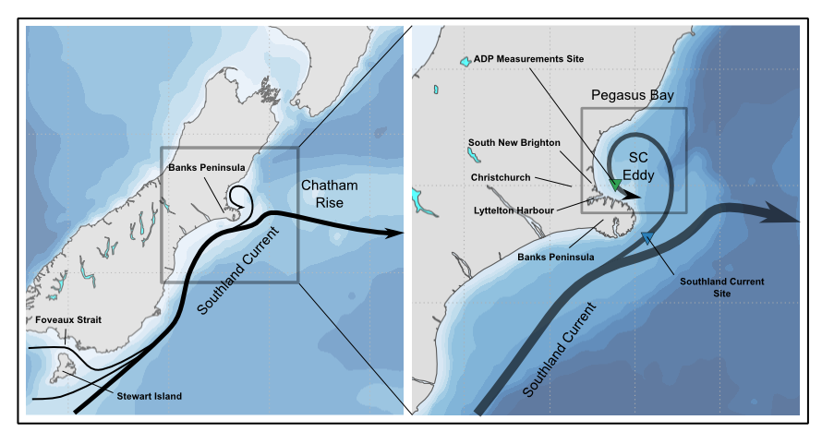
Motivation
According to Chiswell (1996) and Reynolds-Flemming et al. (2005)
www.metocean.co.nz

Slide 3
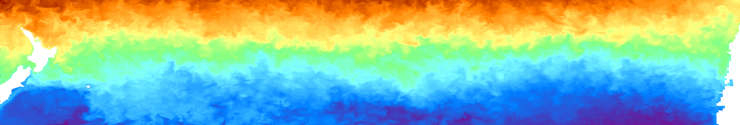
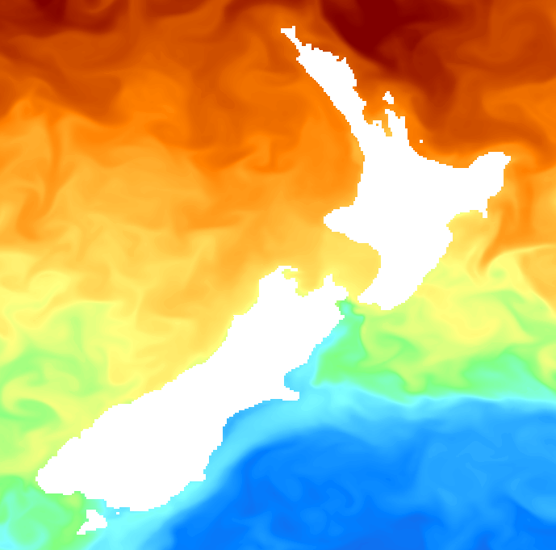
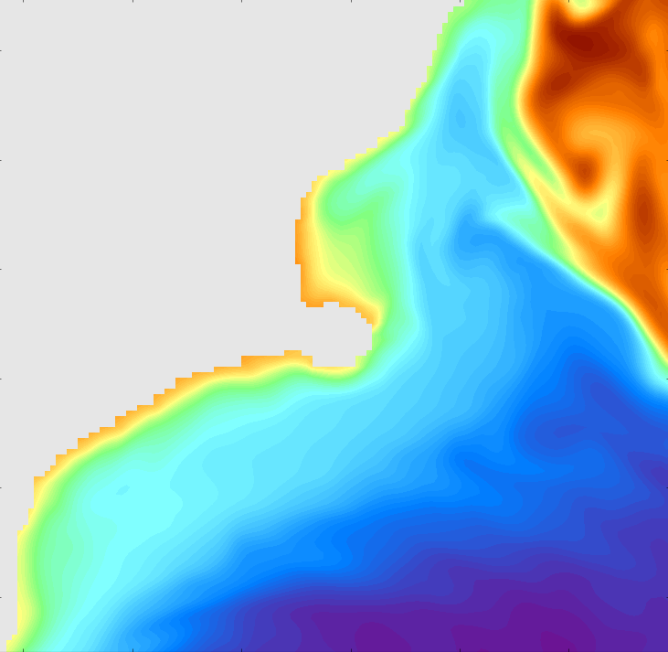
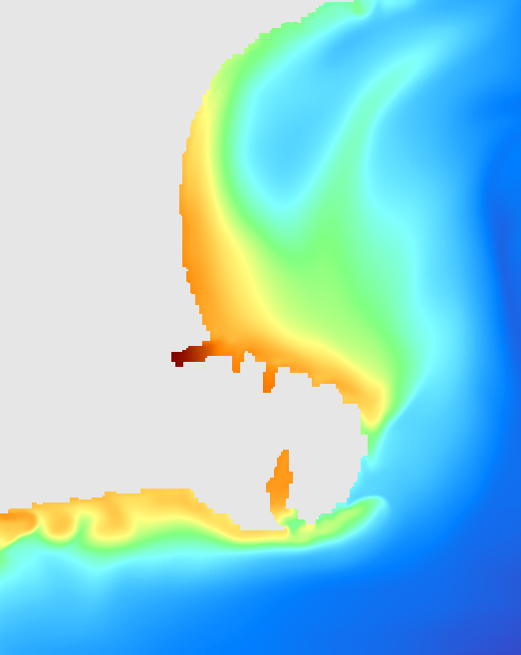
Overview of the forcing mechanisms
NZ
Rossby Waves: ~10-30 days, ~100-200 km
Chile
Eddies + topography +
Local BC instabilities
Southland current eddy
Winds
Coastal jets and waves
Frontal structures
Tides
Winds
100 km
100 km
Rossby Waves
Southland Current
www.metocean.co.nz

Slide 4
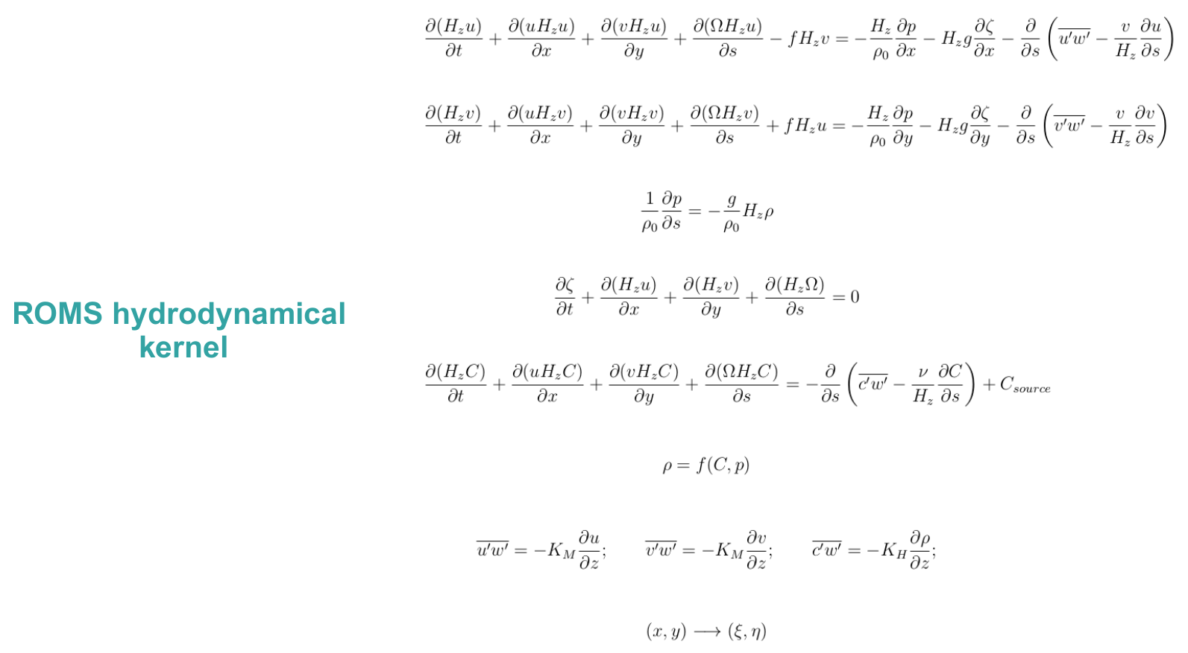
Numerical Model
Haidvogel et al. (2008)
www.metocean.co.nz

Slide 5
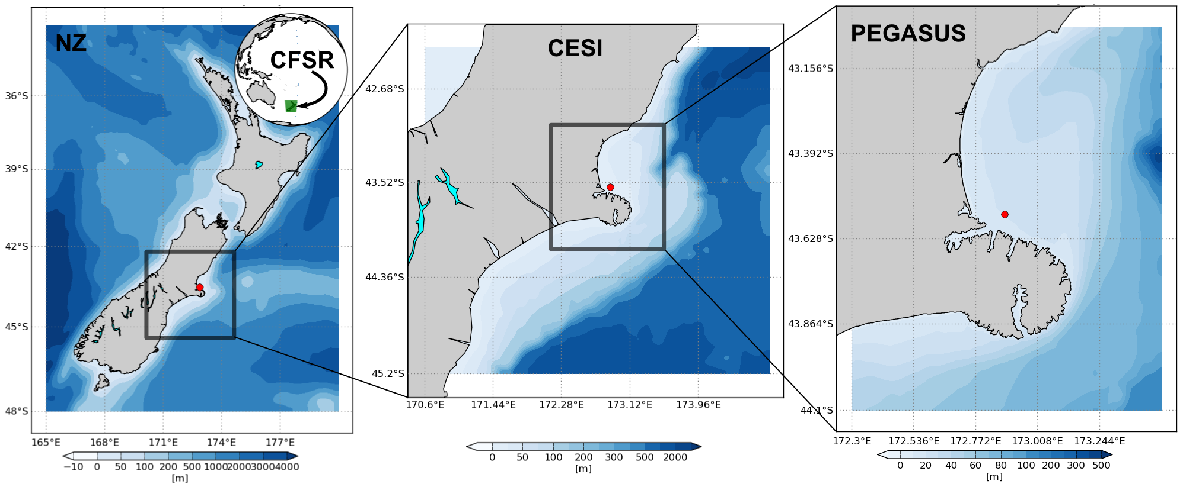
Model setup
www.metocean.co.nz

Slide 6
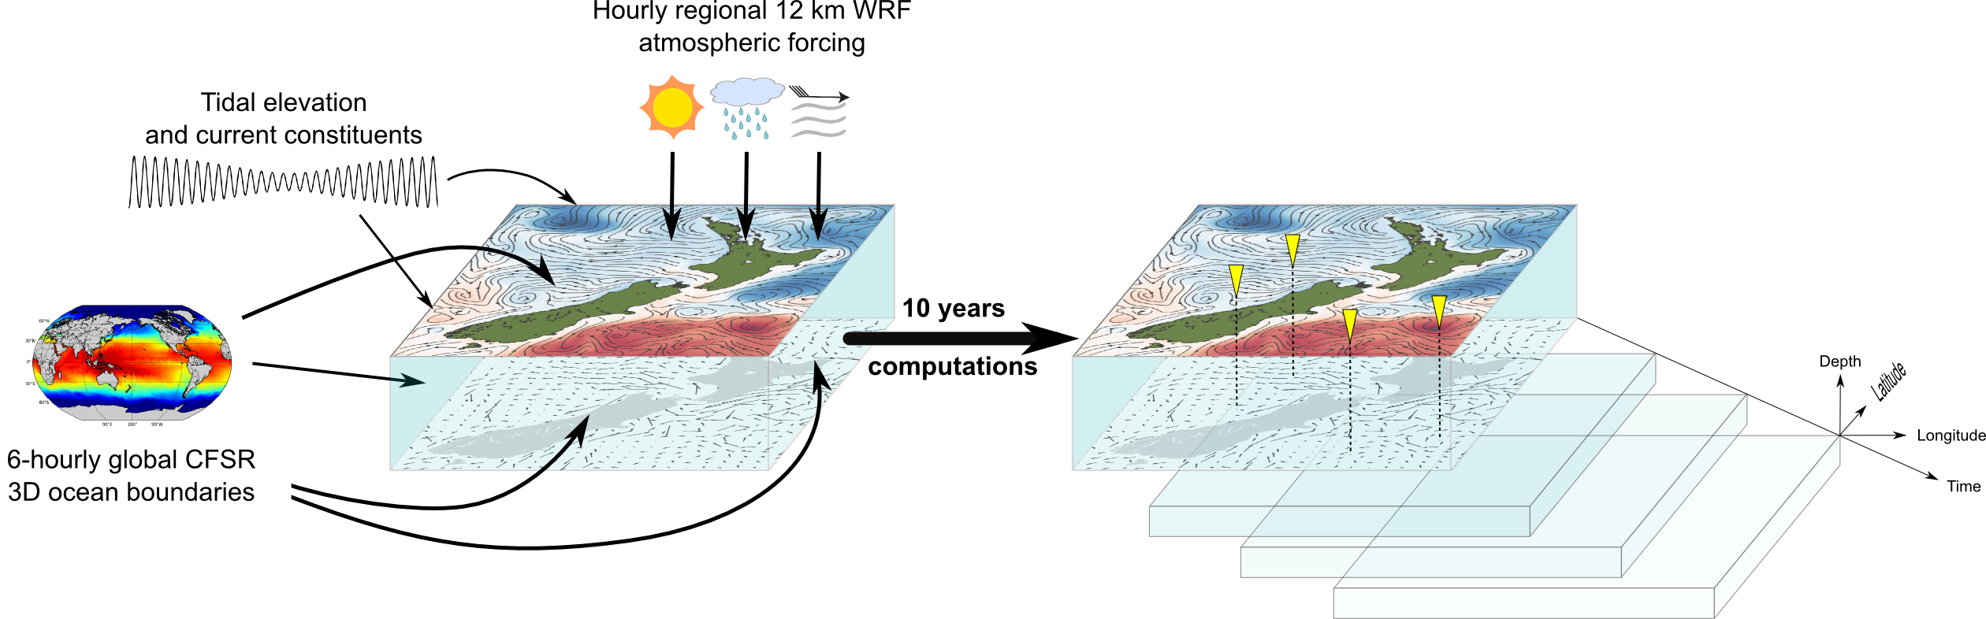
Hindcast approach
www.metocean.co.nz

Slide 7
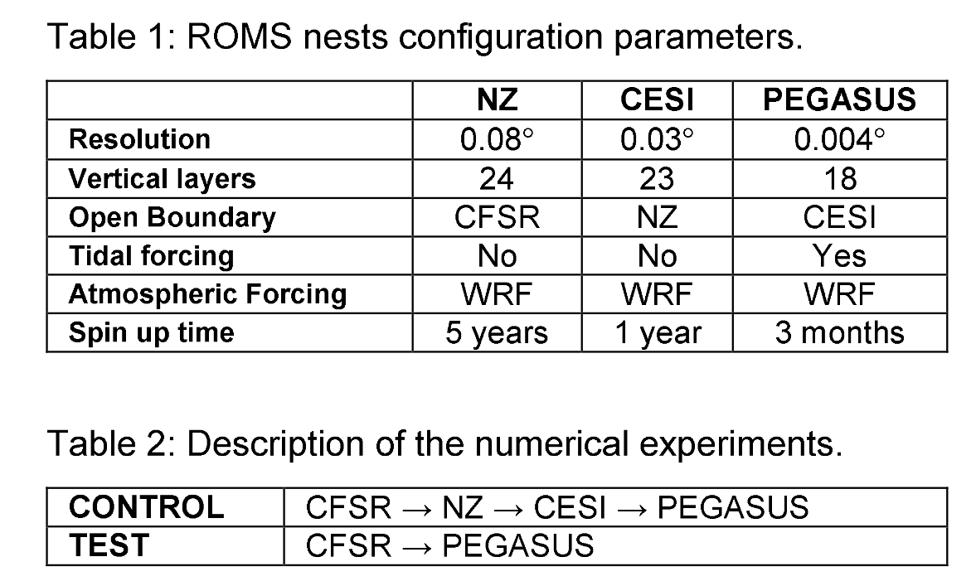
Investigation approach
www.metocean.co.nz

Slide 8
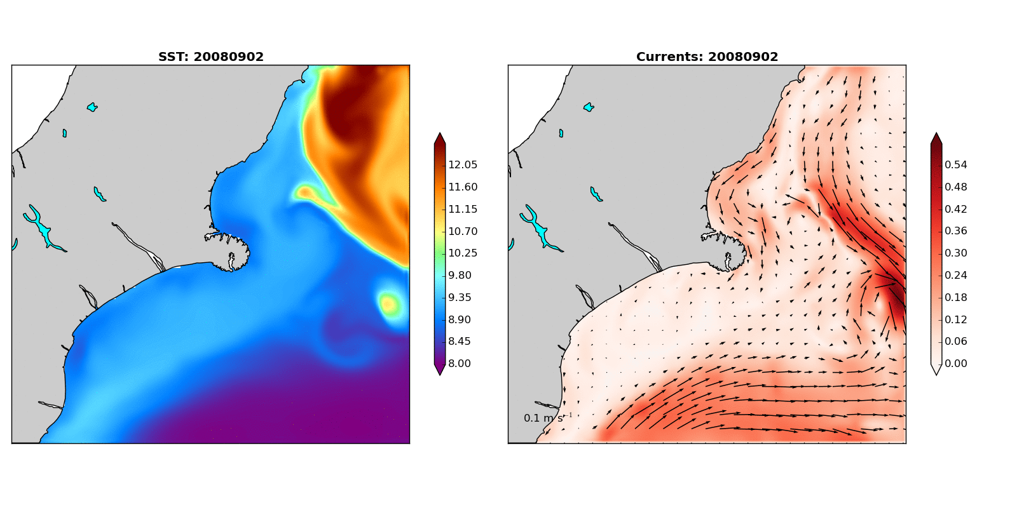
Results
www.metocean.co.nz

Slide 9
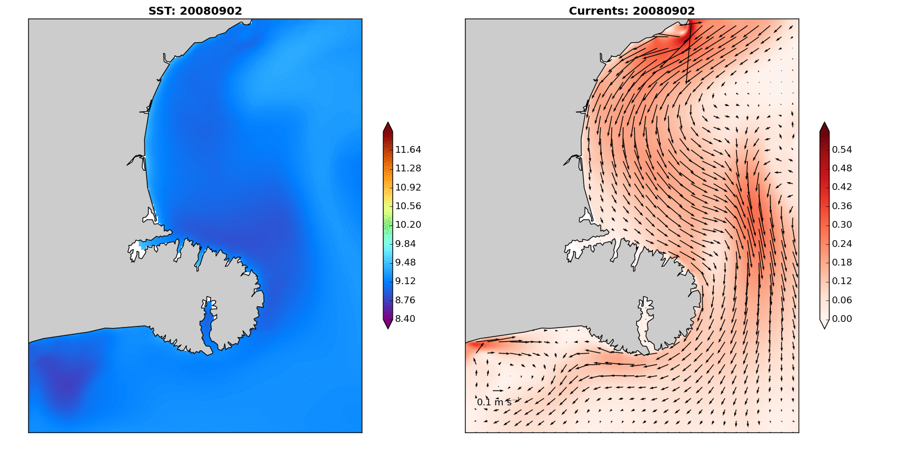
Results
www.metocean.co.nz

Slide 10
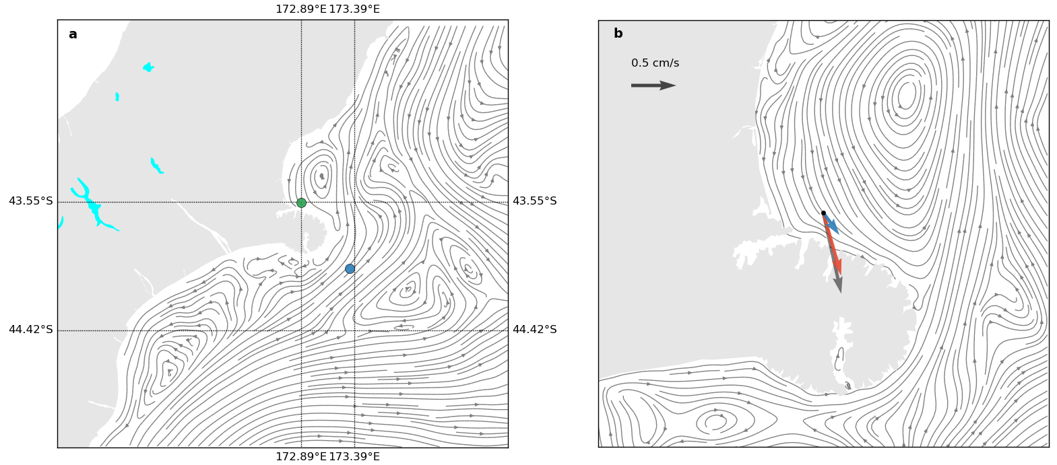
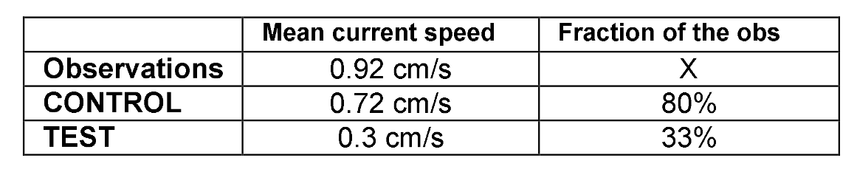
Results – average flow
www.metocean.co.nz

Slide 11
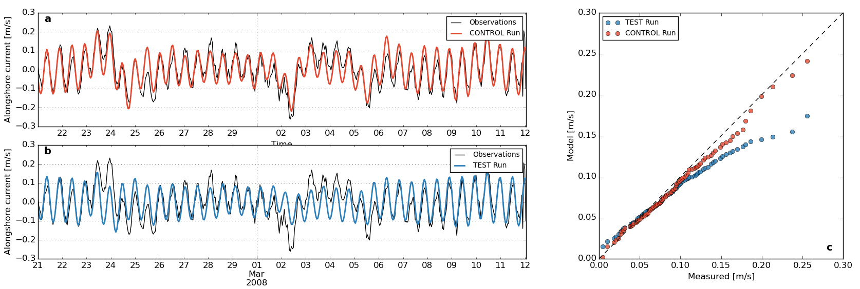
Results – model validation
www.metocean.co.nz

Slide 12
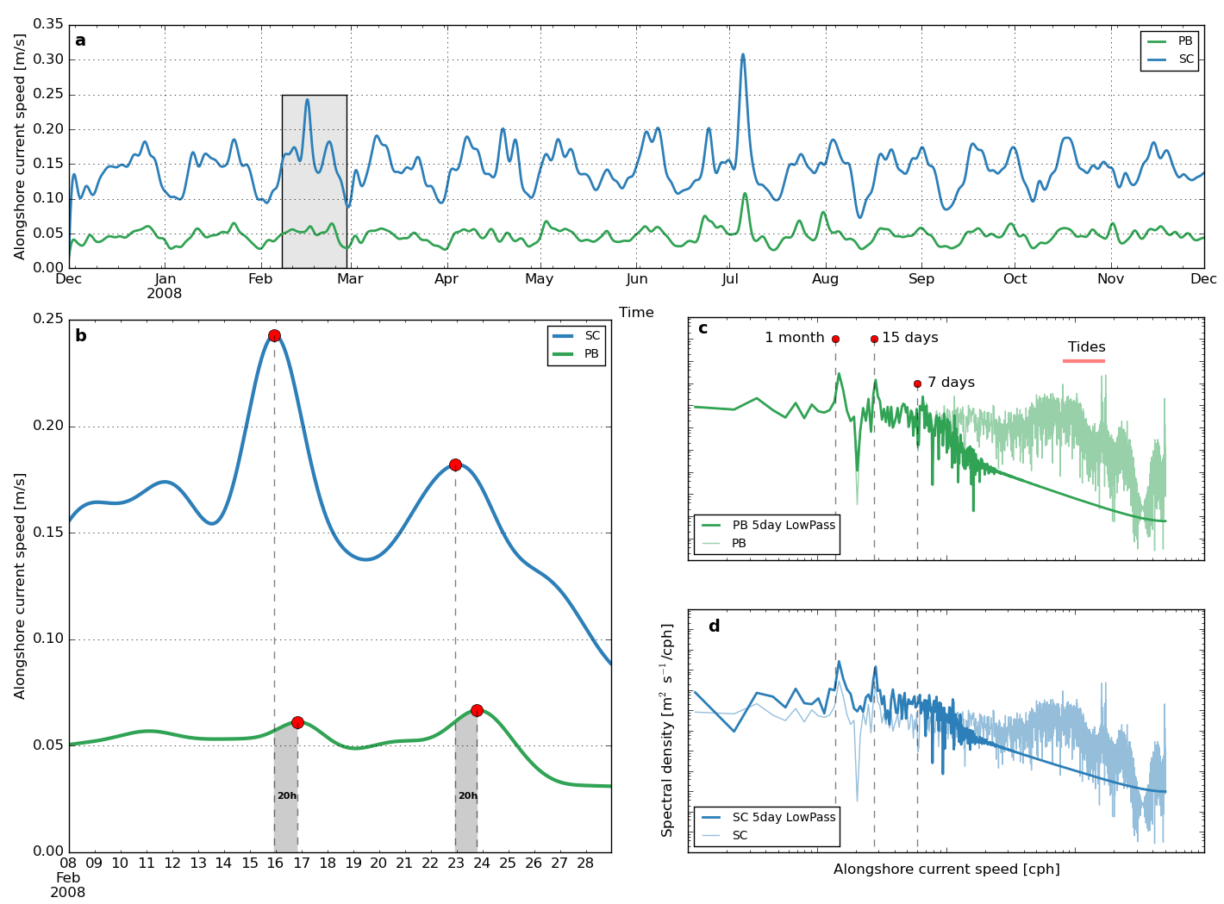
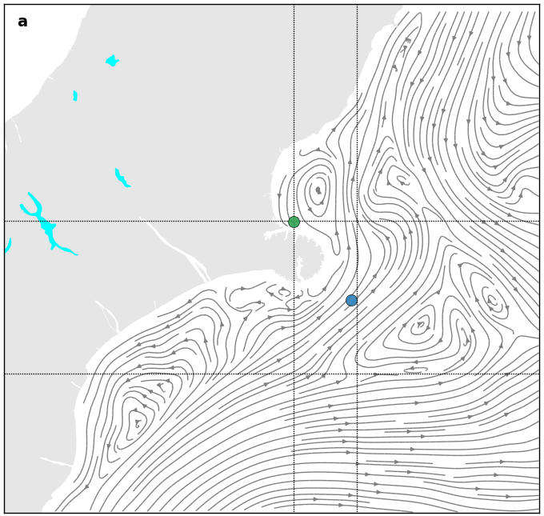
Results – along-shore flow analysis
www.metocean.co.nz

Slide 13
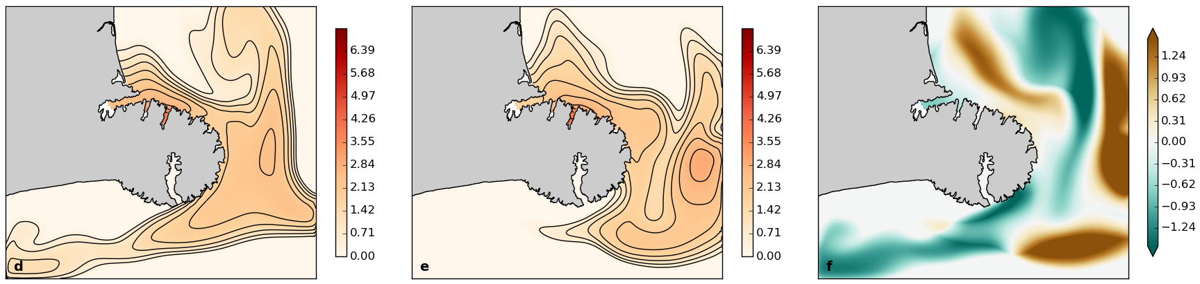
Results – potential effects on plume dispersion
Arbitrary passive tracer release during 15 days
Plots show concentrations 10 days after halt
Control
Test
Test - control
www.metocean.co.nz

Slide 14
Final Remarks
The Southland Current is important for the first order dynamics of the coastal circulation in the inner shelf of Pegasus Bay.
Neglecting its effect is accompanied by substantial underestimation of the currents near the coast, particularly the stronger ones.
Careful downscaling with a hierarchy of nests is fundamental to transfer open ocean dynamics and variability all the way down to the inner shelf.
www.metocean.co.nz

Slide 15
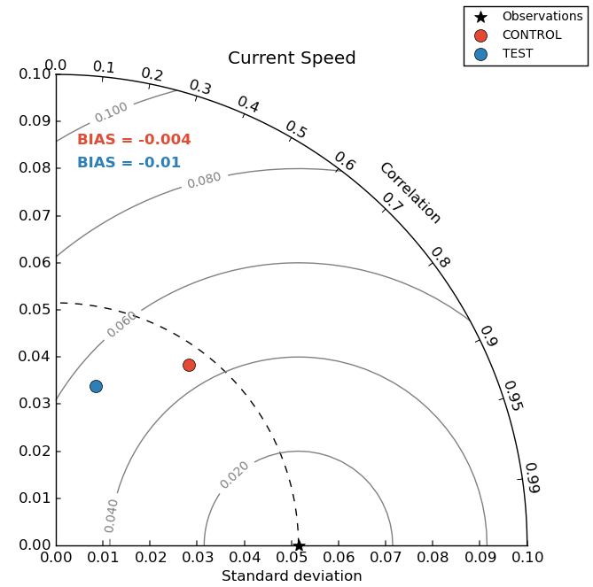
Results – model validation
www.metocean.co.nz

